Slide 1


Project for AI/ML/DL using Python
SMS/MAIL
SPAM DETECTOR
A group presentation by
Triyan Gupta 12211502822 ECE2
Pradyumna Saxena 12011502822 ECE2
Priyanshu 12711502822 ECE2

Slide 2


Introduction
Our inboxes today are hit by a plethora of
unwanted messages.
Spamming not only congests our channels of
communication but also creates security threats.
Our spam detecting system puts machine
learning into play against such a pervasive
problem and offers a smarter, more
efficient way to filter unwanted content
and protect users.

Slide 3


Table of Contents
1
Cleaning and Preparing Data
2
Exploratory Data Analysis
3
Text Pre-processing
4
Model building
5
Understanding Multinomial Naive Bayes
6
Evaluation And improvement
7
Web interface
8
Summary

Slide 4





Programs And Software Involved
Python
Streamlit
Jupyter Notebook
Anaconda navigator
For writing down code to train models
Streamlit turns data scripts into shareable web apps in minutes. All in pure Python
To execute python code in a proper cell-type format for effecient understanding
One stop managing Program for AI/ML with Python
1)

Slide 5


01
Cleaning
And Preparing data
In this critical phase, the dataset is cleaned for analysis with the
help of pandas and numpy etc.
Empty columns are removed to increase data quality.
Label Encoding is used to convert the categorical data into
numerical data hereby cleaning the data.
The above such procedures result in an extremely solid foundation
for the spam detection model.
2)

Slide 6
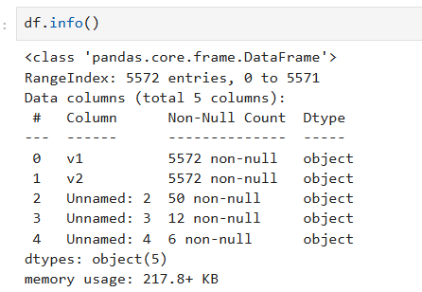
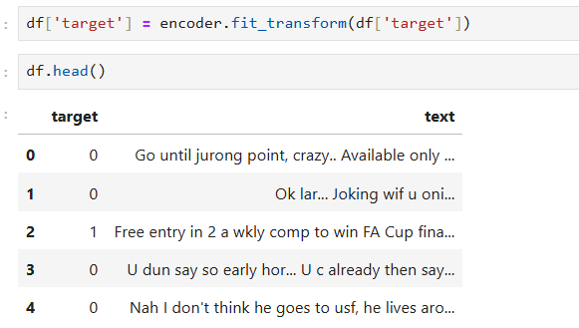
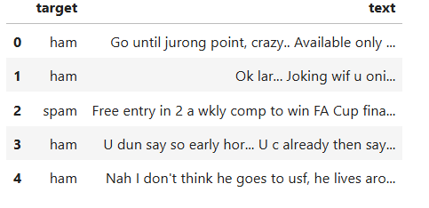
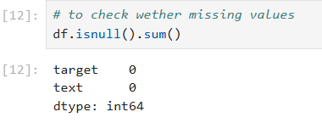
Key Pandas Data-Frame Commands and Their Usages
3)

Slide 7


02
Exploratory
Data analysis (EDA)
In the EDA process, following crucial things were found
out. They are enlisted as follows -
Pie charts were used to visualize the dissemination of spam vs non-spam mail
Seaborn was used to visualize complex patterns
These techniques are the basic framework of preprocessing and modeling strategies for the model.
4)

Slide 8
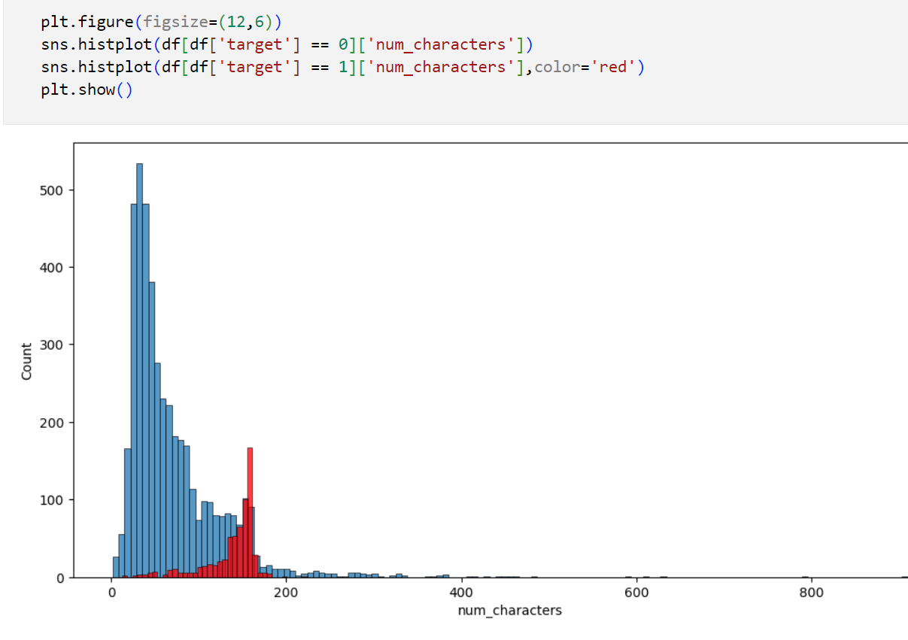
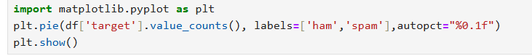
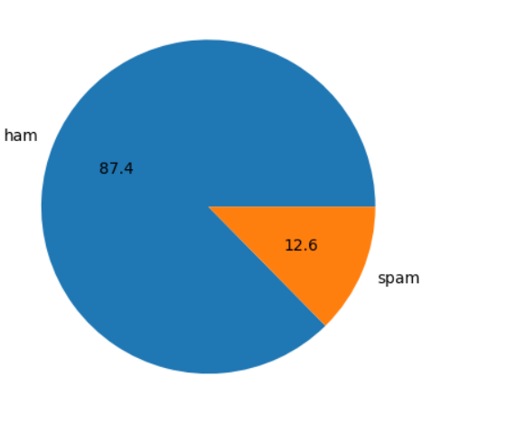
PIE CHART REPRESENTATION
SEABORN PLOTTING
5)

Slide 9



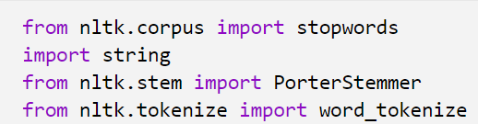
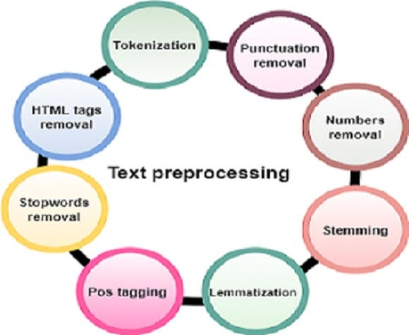
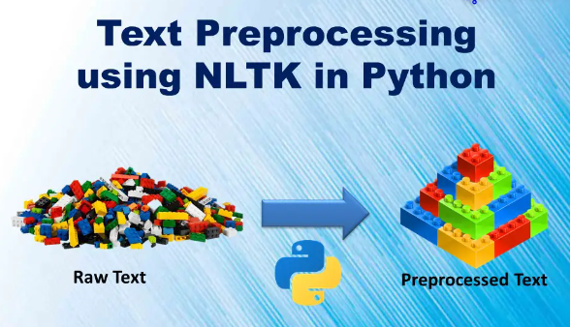
Text Pre-Processing
A strong preprocessing pipeline was set for the model in the following manner:
• Case conversion to lowercase for uniformity
• Tokenizing the messages and getting rid of non-essential elements using nltk etc.
Removing StopWords.
• Stemming to reduce words to their root form
thus greatly improving the quality of the input data for the model.
Natural Language Toolkit
6)

Slide 10
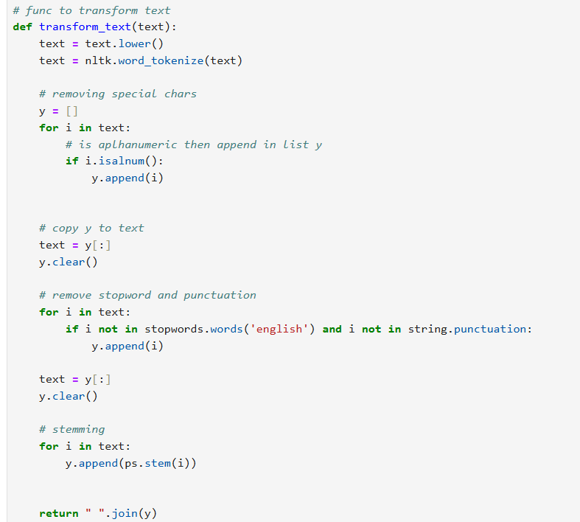
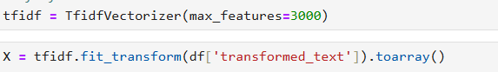
7)
Preprocessing code example

Slide 11
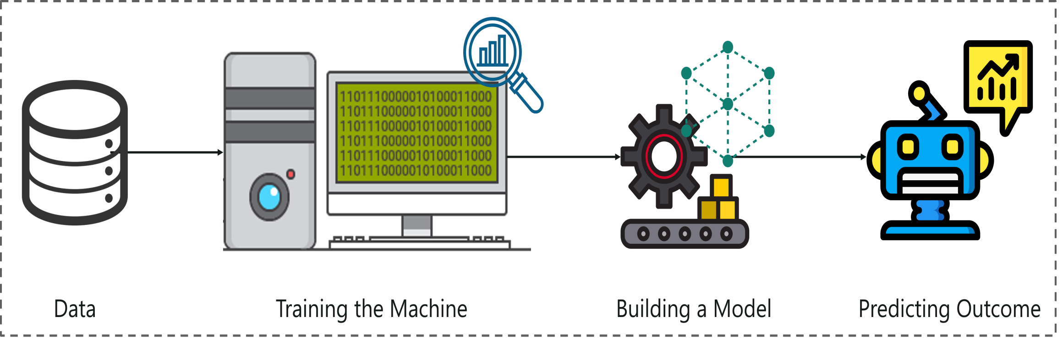

Model Building
Objective 1
Objective 2
Outcome
Implemented the following types of
Naive Bayes Classifiers: Gaussian,
Multinomial, and Bernoulli
It doesn't require as much
training data. It handles both
continuous and discrete data.
It is highly scalable with the
number of predictors and data
points. It is fast and can be used
to make real-time predictions.
Used sklearn for
feature extraction and
data splitting
The sklearn
library contains a lot
of efficient tools for
machine learning
and statistical
modeling
The multi-model
approach that
was adopted
enabled the
performance
comparison for all
of them.
8)

Slide 12
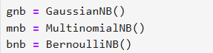
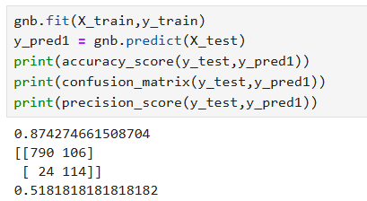
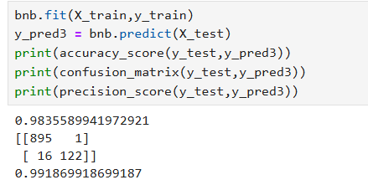
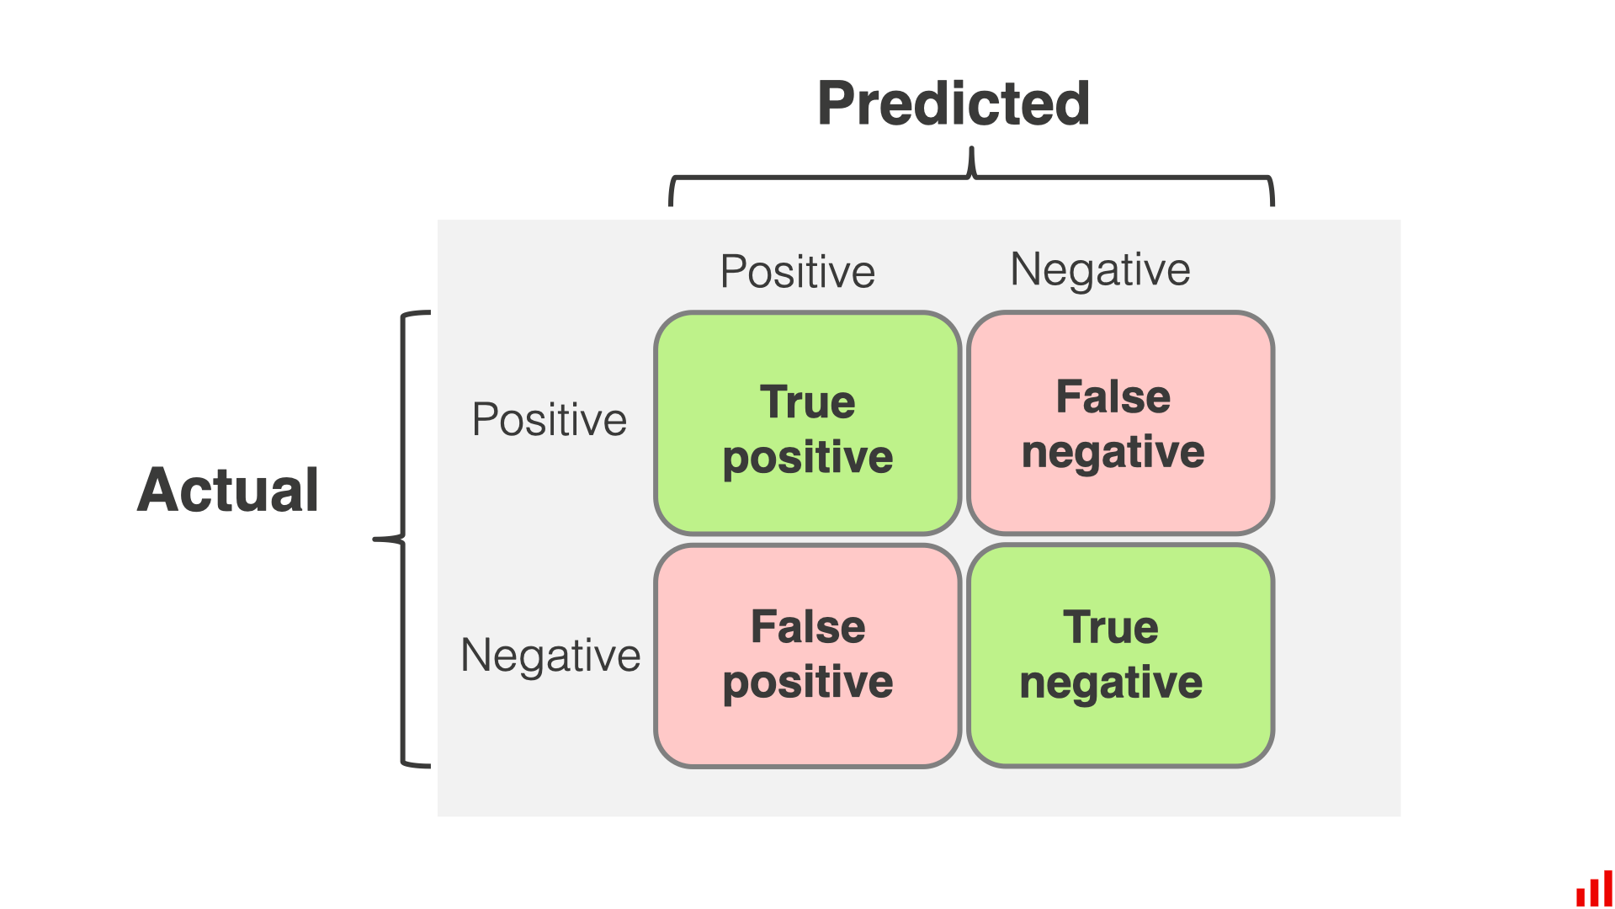
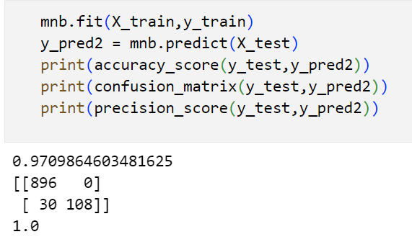
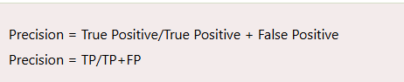
9)
Fit transform and accuracy check of various Naïve bayes Models

Slide 13
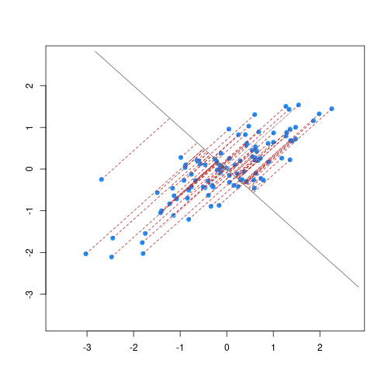

Multinomial
Naive Bayes
Multinomial Naive Bayes is a probabilistic
classifier to calculate the probability distribution of
text data, which makes it well-suited for data with
features that represent discrete frequencies or
counts of events in various natural language
processing (NLP) tasks.
Bayes Theorem
P(c|x) = P(x|c) * P(c) / P(x)
10)

Slide 14


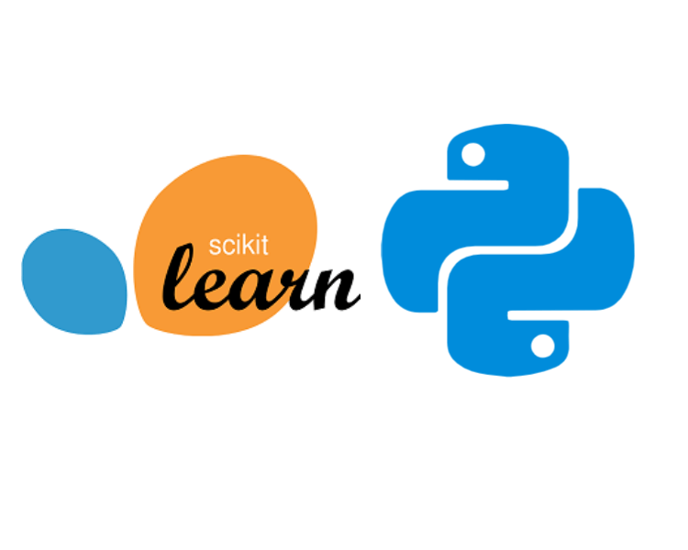
Evaluation and Improvement
System excellence was maintained by the following methods:
#)Rigorous analysis with respect to accuracy, precision, recall imported from sklearn.
#)Iterative model refinement based on above performance metrics
#)Explore more advanced techniques for continued improvement
This process maintains effectiveness of the system in spam detection.
11)

Slide 15

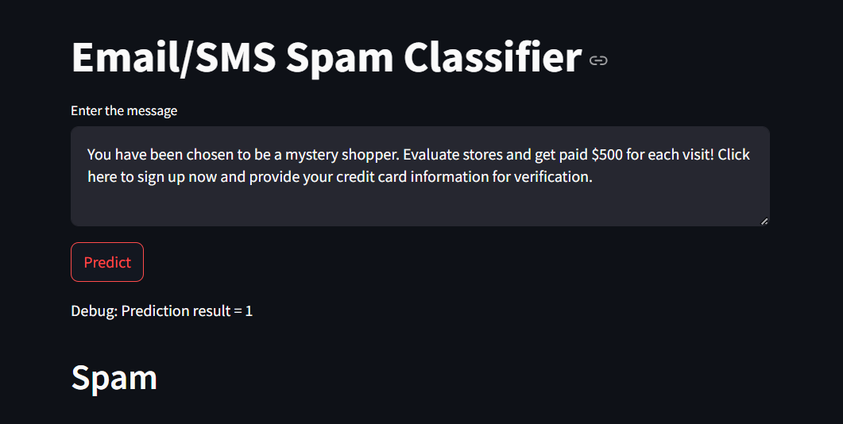
Web Interface and User Interaction
The spam detection system includes a user-friendly web interface implemented with Streamlit.
It offers seamless interaction for users to enter messages for classification.
The system supports a previously trained machine learning model seamlessly in a web environment.
- Real-time predictions are generated and displayed, providing immediate feedback to users
.
General procedure
Final Outcome
- The interface processes user input through a sophisticated text transformation pipeline, which includes NLTK for deeper text processing.
This web component serves as a bridge, providing access to an end-user with spam detection made accessible and intuitive. It shows in real-life situations how our algorithm works, hence proving not only the prowess of our model but also its user-centered implementation.
Visual Representation of our Model
12)

Slide 16



Summary
The Presentation outlines the development of a spam detection system that enhances communication security using machine learning.
1. Data Preparation: Cleaned the dataset by removing empty columns and converting categorical data to numerical values.
2.Exploratory Data Analysis: Used visualizations and text analyses to inform preprocessing and modeling strategies.
3. Text Preprocessing: Established a preprocessing pipeline with case conversion, tokenization, and stemming.
4. Model Building: Implemented and compared various Naive Bayes Classifiers using sklearn.
5. Evaluation: Ensured system effectiveness through rigorous evaluation and iterative refinement.
6. Web Interface: Developed a user-friendly Streamlit interface for real-time message classification, providing immediate feedback and demonstrating model effectiveness.
13)

Slide 17

Thank You
We hope you found our presentation informative and engaging

